Slide 1
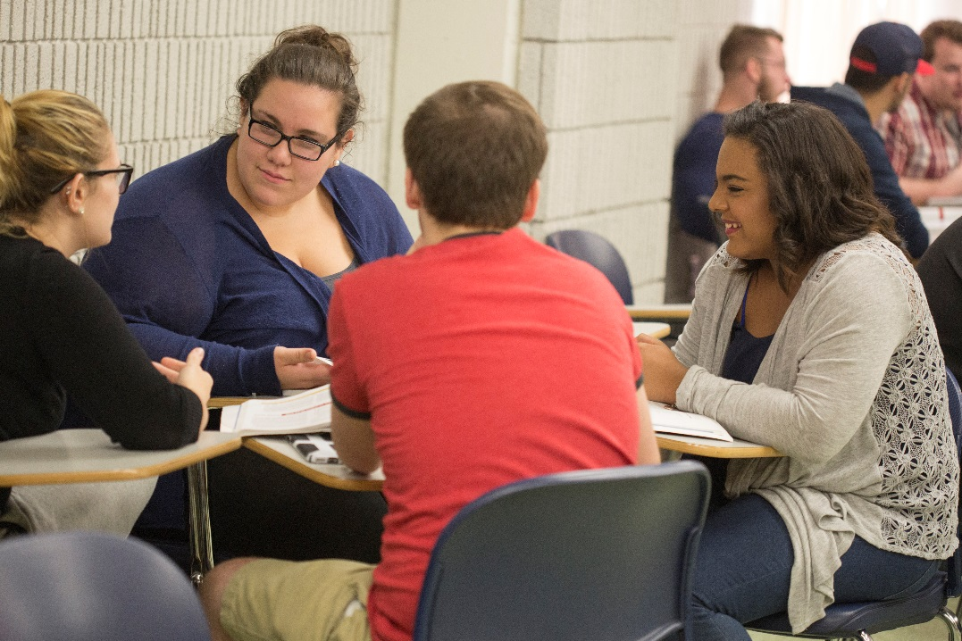
Assessing Student Civic Learning Outcomes
Bristol Community College
Suzanne M. Buglione, Ed.D

Slide 2
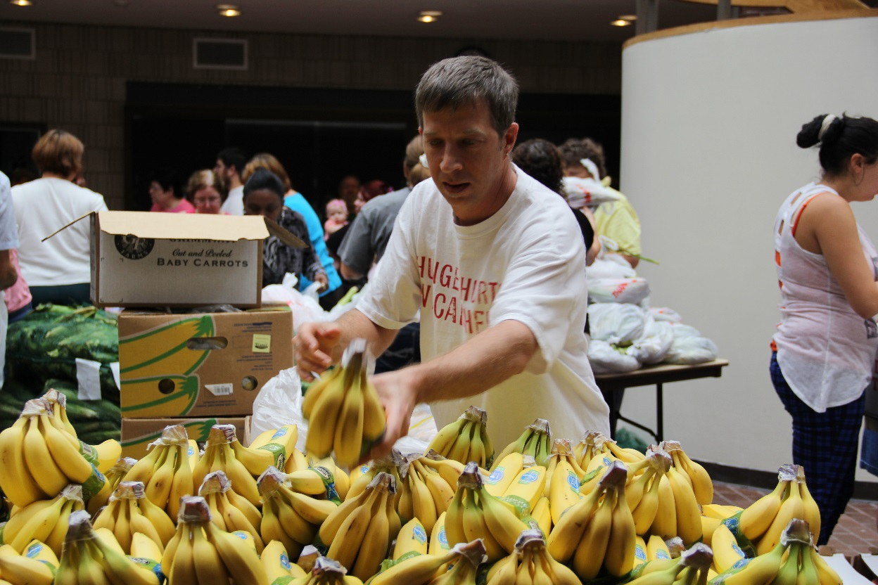
Assessment
Course-level by faculty based on SLOs
Quantitative Data Collection – courses, students, faculty, persistence, retention
Impact Data Collection – pre and post surveys

Slide 3
Assessment
Course-level by faculty based on SLOs
Educational Effectiveness SLO subcommittee review
Course design based on SLOs
Course assessments based on SLOs
At least one reflective assessment – promote more, brief assessments at intervals
Discussion boards
Group discussions & Report backs
One-Minute papers

Slide 4
Assessment
Quantitative Data Collection
Courses flagged by Registrar
Data pulls: # students, # faculty
Persistence (84% as compared to 71%) calculated from one semester to another
Retention calculated from Fall-to-Fall

Slide 5
All Service-Learning Courses
Fall 2015
Spring 2016
25 Sections
6 CLER
21 Faculty
6 CLER
362 Students
86 CLER
22 Sections
5 CLER
18 Faculty
5 CLER
303 Students
58 CLER

Slide 6
Assessment
Impact Data Collection – pre and post surveys
Diaz-Gallegos, D., Furco, A., & Yamada, H. (1990). Higher education service learning surveys. Retrieved from http://www.servicelearning.org/filemanager/down-load/HEdSurveyRel.pdf.
Two intervals in the semester – paper or electronic
Limitations in response rate
Measures Academic, Career, Personal, Volunteerism/Civic Engagement

Slide 7
Assessment
Volunteerism/Civic Engagement | Pre Positive | Post Positive | % CHG
I feel that I can have a positive impact on local social problems. | 75.38% | 84.61% | 12.24%
I plan to improve my neighborhood in the near future. | 60% | 70.76% | 17.94%
Career | Pre Positive | Post Positive | % CHG
I have definite career plans. | 73.84% | 83.07% | 12.5%
It is important to find a career that directly benefits others. | 80% | 92.30% | 15.38%
Personal | Pre Positive | Post Positive | % CHG
What happens to me is my own doing. | 78.46% | 92.30% | 17.64%
I feel that I have little control over the things that happen to me. | 83.07% | 61.53% | -25.92%
The extent of my achievement is often determined by chance. | 66.16% | 58.46% | -11.62%

Slide 8
Assessment
28% of CLER students responded
Focus on changes 10%+
Do you plan to continue your service with this agency? | Do you intend to continue to serve your community in the future? | Did your participation in the service component enhance your understanding of the course material? | I expected to have a positive experience with my Service-Learning. | Did the service-learning component of this course meet your expectations?
61% Yes | 83% yes | 70% yes | 91% yes | 83% yes

Slide 9
Civic Learning Student Comments
I think it was good to volunteer and every class should have this
Hands on experience helped me learn more about my community
I didn't expect to get as much out of it as I did.
I was very pleased with my service learning component, I met great people and discovered the true meaning of giving my free time to others in need.
It linked the issues of poverty that are dealt with today back to the same struggles the poor dealt with during the civil war.
It was very fulfilling. it gave me a purpose in the community and made me feel important. I learned a lot in all of my service learning projects.
Because i now i have a better understanding about my town and makes me want to experience some more new things.

Slide 10
Civic Learning Student Comments
Helping others impacts the world and makes you a part of something bigger than yourself.
I don't think anything could have helped me understand the United States Government more than working with the Charter Review board and of course having a teacher that is so involved in every aspect of Government helped tremendously!
It should be there's a lot of people who are uneducated about the serious things going on in our country
It made me realize what is most important in my life and how to get involved in helping others in need.
Because I learned about things that I used to see every day but did not realize how important it is.

Slide 11
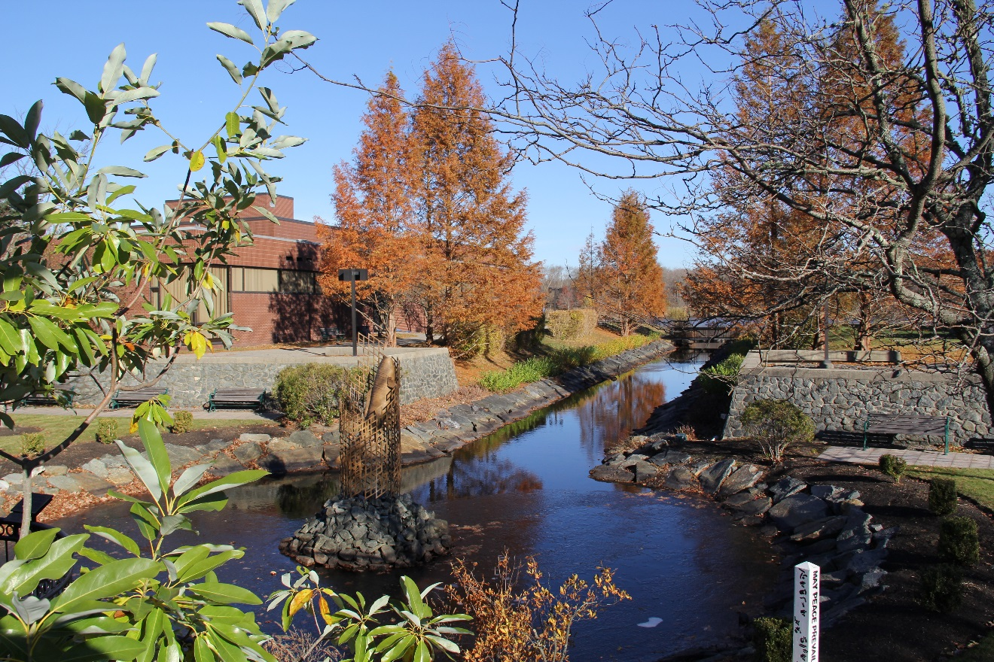
Assessment
Data sharing:
Faculty Forum
College Administration
Program Development
Thank you!

